Slide 1
Operationalizing ML Model with Azure Databricks
Manjunath Suryanarayana
Solutions Architect– Big Data & Advanced Analytics
masuryan@microsoft.com

Slide 2

Azure Databricks
Databricks is the team which started the Spark project at UC Berkeley in 2009, the goad was to make big data simple and building a Unified Analytics Platform.
Azure Databricks is a first party service on Azure.
Unlike with other clouds, it is not an Azure Marketplace or a 3rd party hosted service.
Azure Databricks is integrated seamlessly with Azure services:
Eliminates need to create a separate account with Databricks.
Microsoft Azure

Slide 3


About Me
Solution Architect at Microsoft
Big Data | Machine Learning | AI | Cloud
Around 18+ Years of Experience
Microsoft | IQVIA | Aditi Technologies | Dell | Mindtree
Manjunath Suryanarayana
Product Dev, Services and Sales teams
Engineering| Operations & Management Technology| Leadership | Solution Selling, Pre-Sales
MSc. Information Technology
Microsoft Cloud Certified| Microsoft Big Data Certified | Microsoft Data Science Certified
Contact Me
https://www.linkedin.com/in/manjj/
masuryan@microsoft.com

Slide 4
Agenda
Big Data Lambda Architecutre
Azure Data Lake Store Gen 2 at high Level
Azure Databricks at high level
Advanced Analytics with Spark Mllib 2.x
Serializing a Model
Model Scoring – Requirements to Architectures (Best Practices)
Azure Databricks Model Scoring

Slide 5
Traditional business analytics process
Start with end-user requirements to identify desired reports and analysis
Define corresponding database schema and queries
Identify the required data sources
Create a Extract-Transform-Load (ETL) pipeline to extract required data (curation) and transform it to target schema (‘schema-on-write’)
Create reports. Analyze data
New
requirements
Create ETL pipeline
Identify data sources
Create reports Do analytics
Identify data schema and queries
Relational
Dedicated ETL tools (e.g. SSIS)
ETL pipeline
Queries
LOB Applications
Defined schema
Results
All data not immediately required is discarded or archived

Slide 6
Need to collect any data
Harness the growing and changing nature of data
Structured
Unstructured
Streaming
“ ”
Challenge is combining transactional data stored in relational databases with less structured data
Big Data = All Data
Get the right information to the right people at the right time in the right format
Notes:
Key Points:
Businesses can use new data streams to gain a competitive advantage.
Microsoft is uniquely equipped to help you manage the growing volume and variety of data: structured, unstructured, and streaming.
Talk Track:
Does it not seem like every day there is a new kind of data that we need to understand?
New data types continue to expand—we need to be prepared to collect that data so that the organization can then go do something with it.
Structured data, the type of data we have been working with for years, continues to accelerate. Think how many transactions are occurring across your business.
Unstructured data, the typical source of all our big data, takes many forms and originates from various places across the web including social.
Streaming data is the data at the heart of the Internet of Things revolution. Just think about how many things in your organization are smart or instrumented and generating data every second.
All of this means that data volumes are growing and bringing new capacity challenges. You are also dealing with an enormous opportunity, taking all of this data and putting it to work. In order to take advantage of all this data, you first need a platform that enables you to collect any data—no matter the size or type. The Microsoft data platform is uniquely complete and can help you collect any data using a flexible approach:
Collecting data on-premises with SQL Server
SQL Server can help you collect and manage structured, unstructured, and streaming data to power all your workloads: OLTP, BI, and Data Warehousing
With new in-memory capabilities that are built into SQL Server 2014, you get the benefit of breakthrough speed with your existing hardware and without having to rewrite your apps.
If you’ve been considering the cloud, SQL Server provides an on-ramp to help you get started. Using the wizards built into SQL Server Management Studio, extending to the cloud by combining SQL and Microsoft Azure is simple.
Capture new data types using the power and flexibility of the Microsoft Azure Cloud
Azure is well equipped to provide the flexibility you need to collect and manage any data in the cloud in a way that meets the needs of your business.
Big data in Azure: HDInsight: an Apache Hadoop-based analytics solution that allows cluster deployment in minutes, scale up or down as needed, and insights through familiar BI tools.
SQL Databases: managed relational SQL Database-as-a-service that offers business-ready capabilities built on SQL Server technology.
Blobs: a cloud storage solution offering the simplest way to store large amounts of unstructured text or binary data, such as video, audio, and images.
Tables: a NoSQL key/value storage solution that provides simple access to data at a lower cost for applications that do not need robust querying capabilities.
Intelligent Systems Service: cloud service that helps enterprises embrace the Internet of Things by securely connecting, managing, and capturing machine-generated data from a variety of sensors and devices to drive improvements in operations and tap into new business opportunities.
Machine Learning: if you’re looking to anticipate business challenges or opportunities, or perhaps expand your data practice into data science, Azure’s new Machine Learning service—cloud-based predictive analytics— can help. ML Studio is a fully-managed cloud service that enables data scientists and developers to efficiently embed predictive analytics into their applications, helping organizations use massive data sets and bring all the benefits of the cloud to machine learning.
Document DB: a fully managed, highly scalable, NoSQL document database service
Azure Stream Analytics: real-time event processing engine that helps uncover insights from devices, sensors, infrastructure, applications, and data
Azure Data Factory: enables information production by orchestrating and managing diverse data
Azure Event Hubs: a scalable service for collecting data from millions of “things” in seconds
Microsoft Analytics Platform System:
In the past, to provide users with reliable, trustworthy information, enterprises gathered relational and transactional data in a single data warehouse.
But this traditional data warehouse is under pressure, hitting limits amidst massive change.
Data volumes are projected to grow tenfold over the next five years. End users want real-time responses and insights.
They want to use non-relational data, which now constitutes 85 percent of data growth. They want access to “cloud-born” data, data that was created from growing cloud IT investments.
Your enterprise can only cope with these shifts with a modern data warehouse—the Microsoft Analytics Platform System is the answer.
The Analytics Platform System brings Microsoft’s massively parallel processing (MPP) data warehouse technology—the SQL Server Parallel Data Warehouse (PDW), together with HDInsight, Microsoft’s 100 percent Apache Hadoop distribution—and delivers it as a turnkey appliance.
Now you can collect relational and non-relational data in one appliance.
You can have seamless integration of the relational data warehouse and Hadoop with PolyBase.
All of these options give you the flexibility to get the most out of your existing data capture investments while providing a path to a more efficient and optimized data environment that is ready to support new data types.

Slide 7
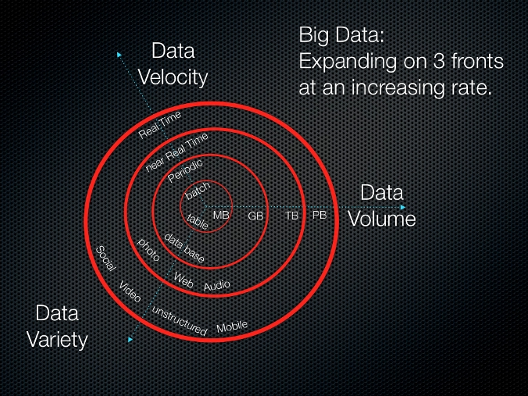
The three V’s
Social and web analytics
Live data feeds
Advanced analytics

Slide 8

New big data thinking: All data has value
All data has potential value
Data hoarding
No defined schema—stored in native format
Schema is imposed and transformations are done at query time (schema-on-read).
Apps and users interpret the data as they see fit
Iterate
Gather data from all sources
Store indefinitely
Analyze
See results
Notes:
All data has immediate or potential value
This leads to data hoarding—all data is stored indefinitely
With an unknown future, there is no defined schema. Data is prepared and stored in native format; No upfront transformation or aggregation
Schema is imposed and transformations are done at query time (schema-on-read). Applications and users interpret the data as they see fit.

Slide 9
Data Lake Store: Technical Requirements
Secure
Must be highly secure to prevent unauthorized access (especially as all data is in one place).
Scalable
Must be highly scalable. When storing all data indefinitely, data volumes can quickly add up
Reliable
Must be highly available and reliable (no permanent loss of data).
Throughput
Must have high throughput for massively parallel processing via frameworks such as Hadoop and Spark
Low latency
Must have low latency for high-frequency operations.
Details
Must be able to store data with all details; aggregation may lead to loss of details.
Native format
Must permit data to be stored in its ‘native format’ to track lineage & for data provenance.
All sources
Must be able ingest data from a variety of sources-LOB/ERP, Logs, Devices, Social NWs etc.
Multiple analytic frameworks
Must support multiple analytic frameworks—Batch, Real-time, Streaming, ML etc. No one analytic framework can work for all data and all types of analysis.

Slide 10

The “data lake” Uses A Bottoms-Up Approach
Ingest all data regardless of requirements
Store all data
in native format without schema definition
Do analysis
Using analytic engines like Hadoop
Devices
Social
Batch queries
LOB applications
Video
Devices
Interactive queries
LOB applications
Social
Real-time analytics
Web
Sensors
Sensors
Video
Machine Learning
Relational
Web
Clickstream
Data warehouse
Relational
Clickstream

Slide 11

Intelligent applications – Lambda Architecture
INGEST
STORE
PREP & TRAIN
MODEL & SERVE
Cosmos DB
Logs, files and media
(unstructured)
Azure IoT Hub
SQL
SQL Database
Predictive apps
Azure HDInsight (Kafka)
Azure Databricks / HDInsight
Sensors and IoT
(unstructured)
Polybase
Business/custom apps
(Structured)
Operational Reports
&
Analytical Dashboards (PowerBI)
Azure Data Factory
Azure Blob Storage
Azure SQL Data Warehouse
Azure Analysis Services

Slide 12



Azure Databricks
Azure Databricks
Collaborative Workspace
IoT / streaming data
Machine learning models
DATA ENGINEER
DATA SCIENTIST
BUSINESS ANALYST
Deploy Production Jobs & Workflows
Cloud storage
BI tools
MULTI-STAGE PIPELINES
JOB SCHEDULER
NOTIFICATION & LOGS
Data warehouses
Optimized Databricks Runtime Engine
Data exports
Hadoop storage
DATABRICKS I/O
APACHE SPARK
SERVERLESS
Rest APIs
Data warehouses
Enhance Productivity
Build on secure & trusted cloud
Scale without limits
Notes:
Databricks, founded by the team that created Apache Spark – unified analytics platform that accelerates innovation by unifying data science, engineering & business.
75% of the code committed to Apache Spark comes from Databricks
Unified Runtime
Create clusters in seconds, dynamically scale them up and down.
They’ve made enhancements to Spark engine to make it 10x faster than open source Spark
Serverless- Auto-configured multi-user cluster, Reliable sharing with fault isolation
Unified Collaboration
Overall – a simple & collaborative environment that enables your entire team to use Spark & interact with your data simultaneously
DE – Improve ETL performance, zero management clusters. Execute production code from within notebooks
DS - For data scientists, easy data exploration in notebooks
Business SME – interactive dashboards empower teams to create dynamic reports
Enterprise Security
Encryption
Fine grained Role-based access control (files, clusters, code, application, dashboard)
Compliance
Rest APIs
DE – DBIO, SPARK, API’s , JOBS
DS – Spark and Serverless, Interactive Data Science
Data Products - Everything
Creators of Spark
Training People
Number of Customers
Ingest
Workflow
Schedule / Run / Monitor
Execute
Troubleshoot
Debug
Production Jobs
---------
Ingest, ETL, Scheduling, Monitoring

Slide 13
Azure Data Lake Storage Gen2

Slide 14


Evolving Data Lake Strategy
Past
Present
Future
WASB
WASB
ADLS
Azure Data Lake Storage Gen2
Blob Storage + (WASB)
Blob Storage + (WASB)
Azure Data Lake Store (ADLS)
Scalable, secure storage that speeds time to insight
Scale and Availability
Scale and Availability
Speed to Insight
Scale and Availability
Speed to Insight
Cost Effectiveness
Cost Effectiveness
Rich Security
Cost Effectiveness
Rich Security
Azure Data Lake Storage Gen2: Single Data Lake Store that combines the performance and innovation of ADLS with the scale and rich feature set of Blob Storage

Slide 15
Azure Data Lake Storage Gen2 Key Features
Hadoop Compatible File System Interface for Blob Storage
Atomic file and folder operations (faster job execution, and fewer transactions)
Fine grained ACLs (File and Folder permissions)
Limitless storage (Azure Storage account enhancements)
Pricing based on the Azure Blob Storage pricing model
Availability in all Azure regions at GA
Optimized for Hadoop and Spark analytic engines

Slide 16
Azure Data Lake Storage Gen 2 Key Messages
Productive
Secure
Cost Effective
Scalable
Easy to get started, quick time to value, superior performance
Single store for file system and object data
Ingest data from everywhere using familiar protocols
Optimized for Spark and Hadoop Analytic Engines
Enables fastest end to end job execution of any vendor (cloud or on-premises)
Multi-layered security including fine grained ACLs
POSIX compliant, fine grained file and folder level permissions
Azure Active Directory Integration (soon)
At-Rest Encryption using MSFT or Customer Managed Keys
Storage Account Security
Object store pricing, atomic file operations object level tiering
Blob Storage Price Levels
Single store where Hot, Cool, and Archive Tiers of Storage are co-resident
Automated Lifecycle Policy Management (soon)
Integration with Azure reporting and management solutions
Exabyte storage scale, industry best availability
Limitless Storage Accounts
Exabyte Storage Scale
Available in all Azure Regions (at GA)
Zone Redundant and Geo Redundant Storage for HA/DR

Slide 17
Azure Data Lake Storage Gen2 Frequently Asked Questions
Q. Is Azure Data Lake Store going away?
Q. If my customer is ready to go into production, what are their options?
Q. Is evaluation/upgrade guidance available?
No.
Azure Data Lake Storage Gen1 will continue operating in the regions where it is currently supported.
Existing Azure Data Lake Storage Gen1 customers will continue to be supported on Azure Data Lake Storage Gen1 (operationally, bug fixes, etc.) until they are ready to upgrade to Azure Data Lake Storage Gen2.
Going forward, new storage features and regional availability will only be added to Azure Data Lake Storage Gen2.
Several.
If your customer has completed an Azure Data Lake Storage Gen1 trial and/or is ready to deploy their Big Data analytics workload in production, then your customer should move forward with Azure Data Lake Storage Gen1.
If your customer has completed an evaluation and needs production support in regions where Azure Data Lake Storage Gen1 is not available, you should advise them to deploy on Blob Storage via the WASB adapter.
In either case, you should convey to your customer that an upgrade path to Azure Data Lake Storage Gen2 will be available once Azure Data Lake Storage Gen2 reaches General Availability.
Yes.
Microsoft will provide tooling, support and guidance to evaluate Azure Data Lake Storage Gen2.
Detailed upgrade guidance will be available when ADLS Gen 2 becomes generally available.
ADLS Gen1 and Blob Storage/WASB customers should work closely with their sales team during the preview process to understand upgrade requirements and to identify resources required for a successful upgrade.
Detailed field guidance on its way

Slide 18

Apache Spark
An unified, open source, parallel, data processing framework for Big Data Analytics
Spark SQL
Interactive Queries
Spark MLlib
Machine Learning
Spark Streaming
Stream processing
GraphX
Graph Computation
Spark Unifies:
Batch Processing
Interactive SQL
Real-time processing
Machine Learning
Deep Learning
Graph Processing
Spark Core Engine
Yarn
Mesos
Standalone Scheduler
Spark MLlib
Machine Learning
Spark Structured Streaming
Stream processing

Slide 19
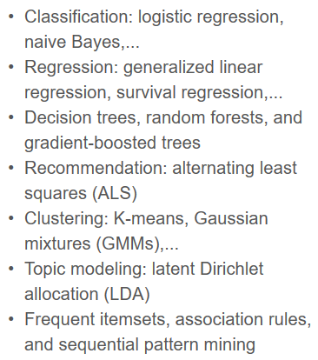
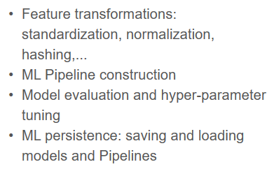

Apache Spark MLlib
Scalable Machine Learning Library
Distributed algorithms that scale linearly with data
Algorithms cover most of the use cases, includes
Machine Learning workflow utilities
Migration to Spark Dataframe started with 1.3
Contribution by 75+ orgs
Built around the concept of Pipeline (Scikit – Learn)
Agile Modeling Process
Spark Structured Streaming
Stream processing

Slide 20
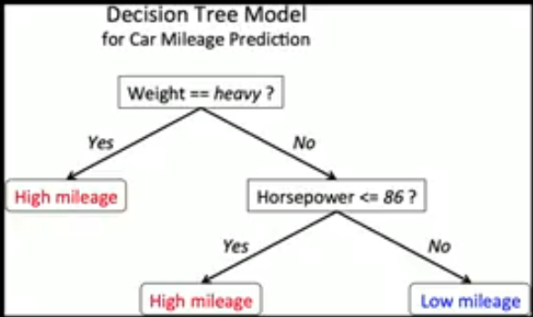
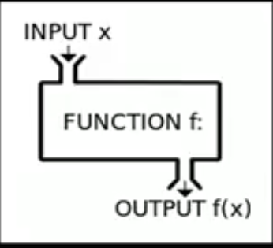
Machine Learning Model
The process of training an ML model involves providing an ML algorithm (that is, the learning algorithm) with training data to learn from. The term ML model refers to the model artifact that is created by the training process.
A Model is a Mathematical Function f(x)
Eg. Linear Regression
Y = b0 + b1X1 + b2X2
Spark Structured Streaming
Stream processing

Slide 21
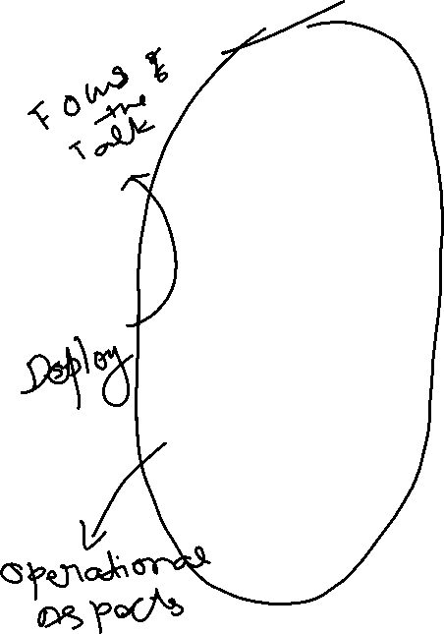
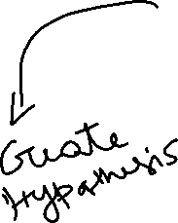
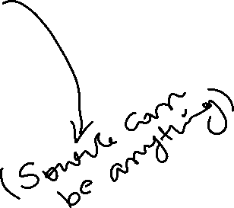
Modeling Data Science Process
Historical Data
[features + labels]
Future Data
[features only]
Define Objective
Split
Training Data
[features + labels]
Testing Data
[features + labels]
Access and Understand the data
Train Model
[model learns from training data]
Score Model
[model predicts on future data]
*
Score Model
[model predicts on testing data]
Pre-processing
Prediction Results
Evaluate Model
[Compare predicted results and true labels]

Slide 22
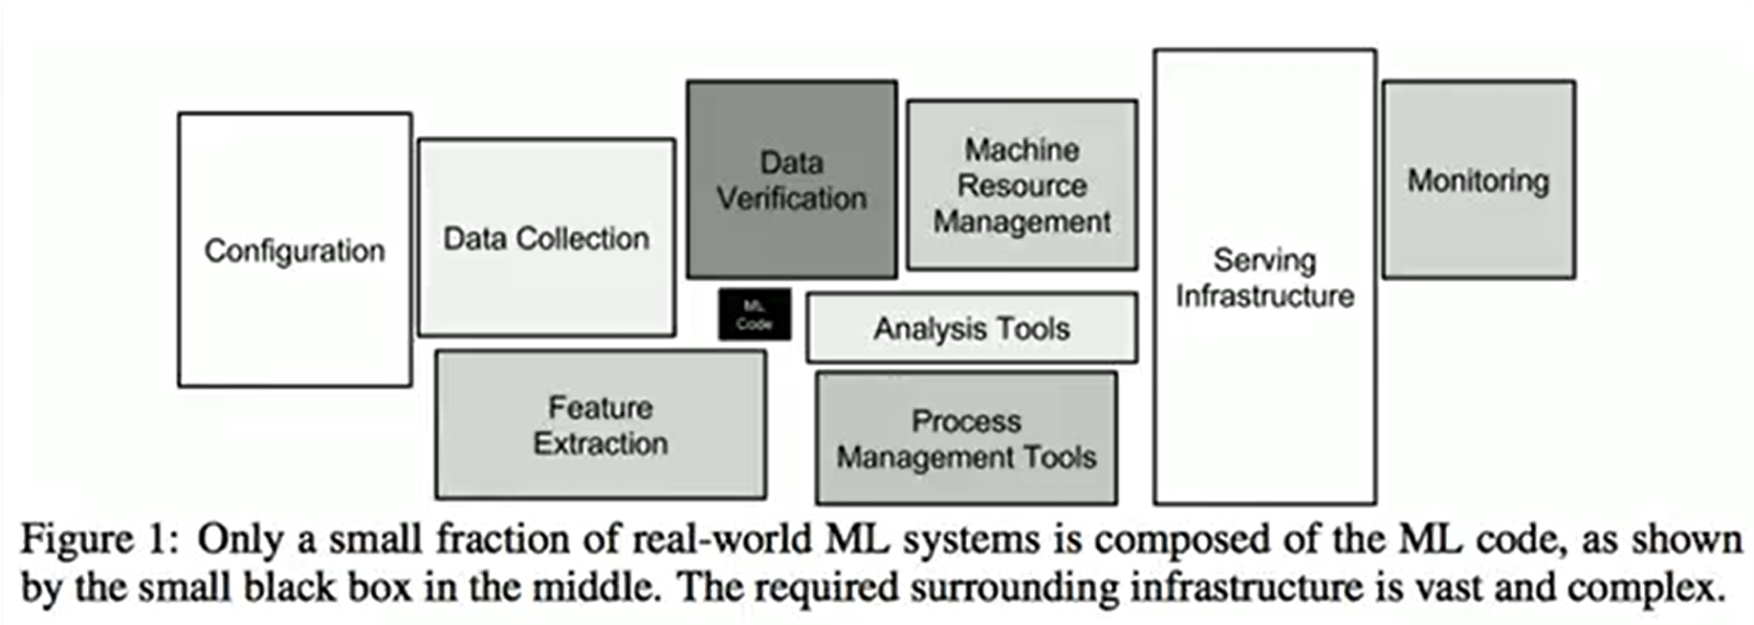
Hidden Technical Debt in ML System
Feedback:
One-line title
Would introduce three buckets similarly to slide 13
Prep and curate
Train and evaluate
Operationalize and manage
One-line title
Take AML out of ML, put it into operationalize and manage
Action:
Update title
Update iconography
Create an option with a process flow
Update layout

Slide 23
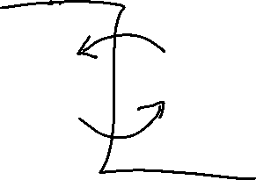
Challenges with Productionizing a Model
Data Science Team
Develop Prototype (Includes Research activities)
Model using Python/R (Mostly on Sample Data)
Data Engineering
Re-implement model for Production (Java, Python)
Additional work
Different Frameworks, code paths and tools
Very tough to implement Agile process Methodologies (like CI and CD etc)
Slow to update Models
Nearly impossible to maintain versioning of Data and Model
Data Science doesn’t translate to production
Spark Structured Streaming
Stream processing

Slide 24
Why do we need Robust Model Deployment System

Slide 25
Different environments where Model gets deployed
Feedback:
One-line title
Would introduce three buckets similarly to slide 13
Prep and curate
Train and evaluate
Operationalize and manage
One-line title
Take AML out of ML, put it into operationalize and manage
Action:
Update title
Update iconography
Create an option with a process flow
Update layout
Web Application / e-commerce portals
Batch Processing Systems / Hadoop / RDBMS (SQL Server)
Real time Processing Systems / Middleware (Biztalk or Service Bus)
Web APIs / Microservices / Modern Infra or Cloud based serverless architecture (Azure Functions)
Embedded in Devices (Mobile Phones, Medical Devices etc.)

Slide 26
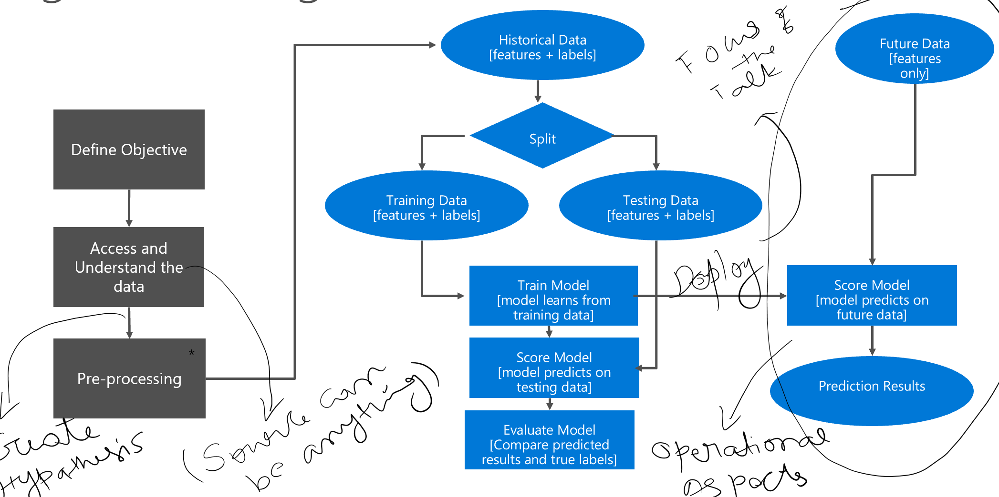
Bring Agile to this process
Deployment Should support A/B testing and experiments
Support Measuring and Evaluating model performance
Entire process should be fast and adaptive

Slide 27
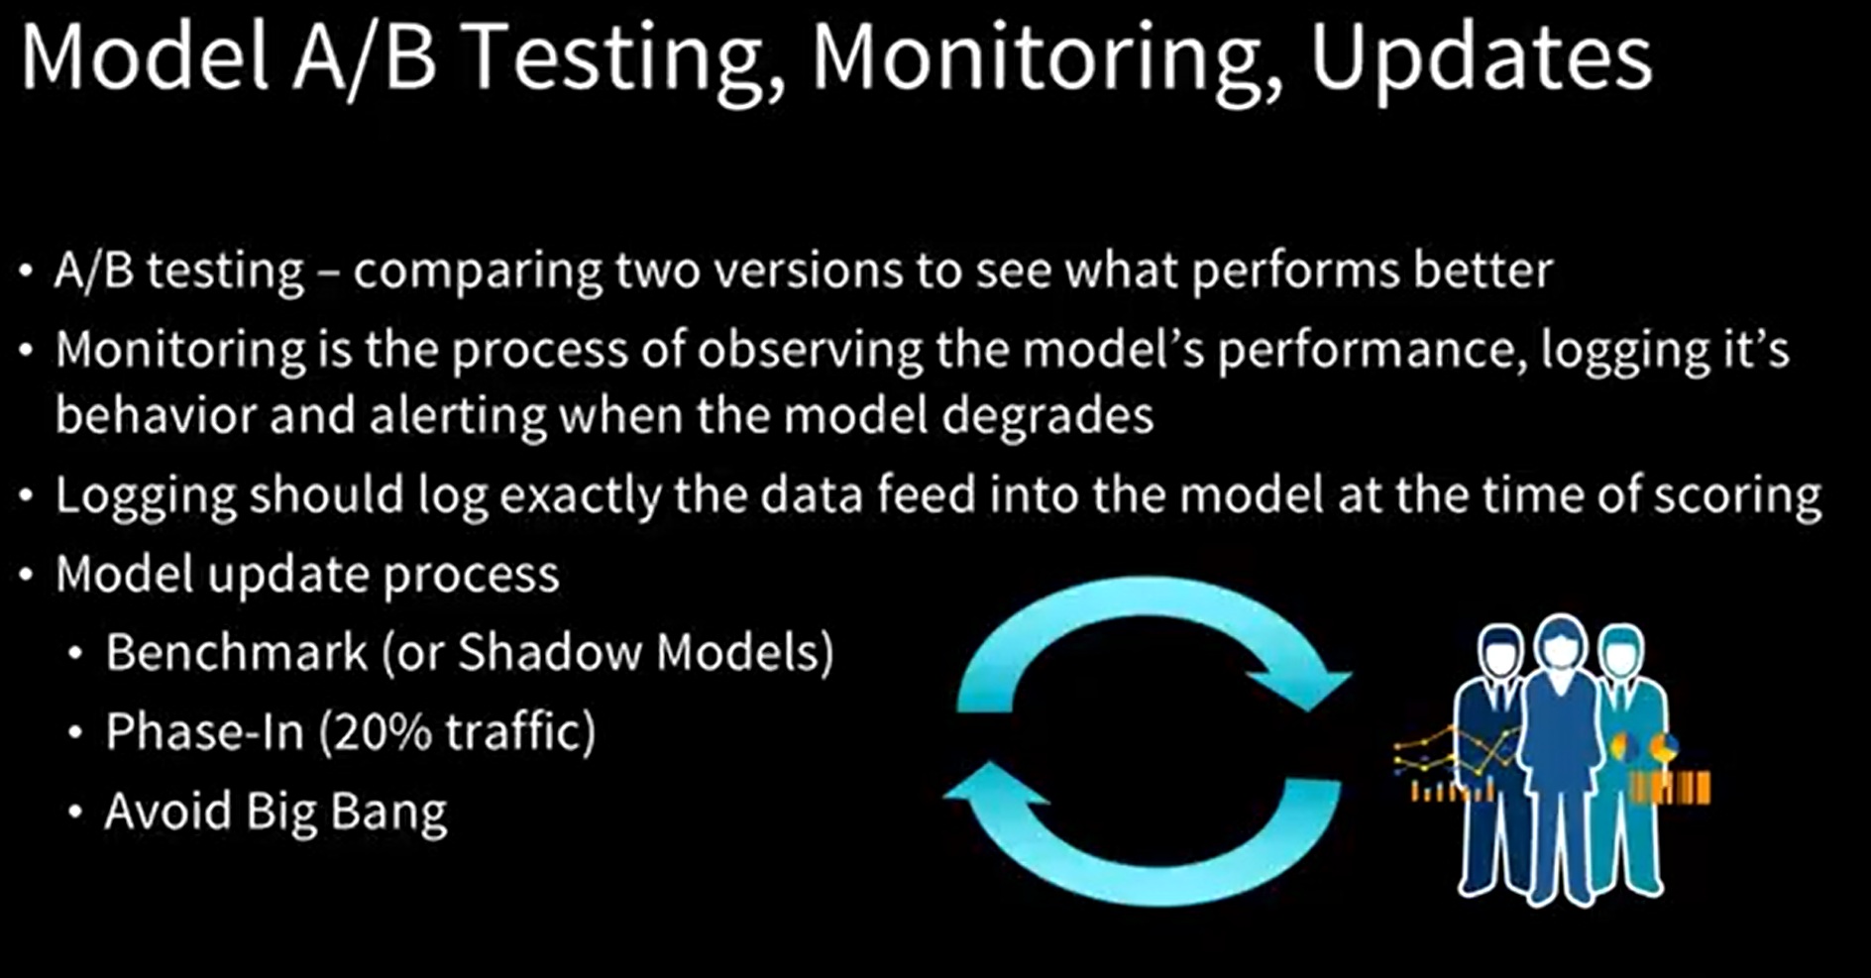
Different environments where Model gets deployed
Feedback:
One-line title
Would introduce three buckets similarly to slide 13
Prep and curate
Train and evaluate
Operationalize and manage
One-line title
Take AML out of ML, put it into operationalize and manage
Action:
Update title
Update iconography
Create an option with a process flow
Update layout
Notes:
Always remember, your algorithm or code never breaks in the ML world, it is data which will break the model. So Logging the data feed is very important.
Shadow Models are set up like Pre-Prod Environment.

Slide 28
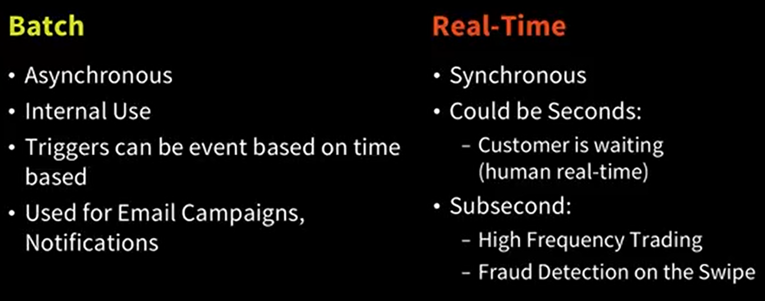
Ideal Scoring Environment
SLAs to Consider
Response Time
Throughput (predictions per second)
Uptime / Reliability
Technology Stack
C/C++
Legacy (Mainframe)
Java/C#
Spark Structured Streaming
Stream processing

Slide 29
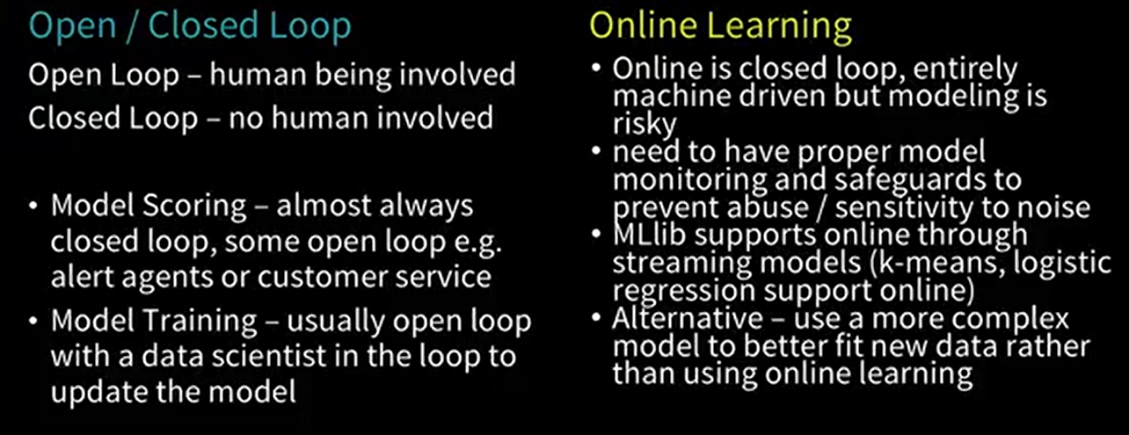
Online Learning and Open/Closed Loop
Spark Structured Streaming
Stream processing

Slide 30
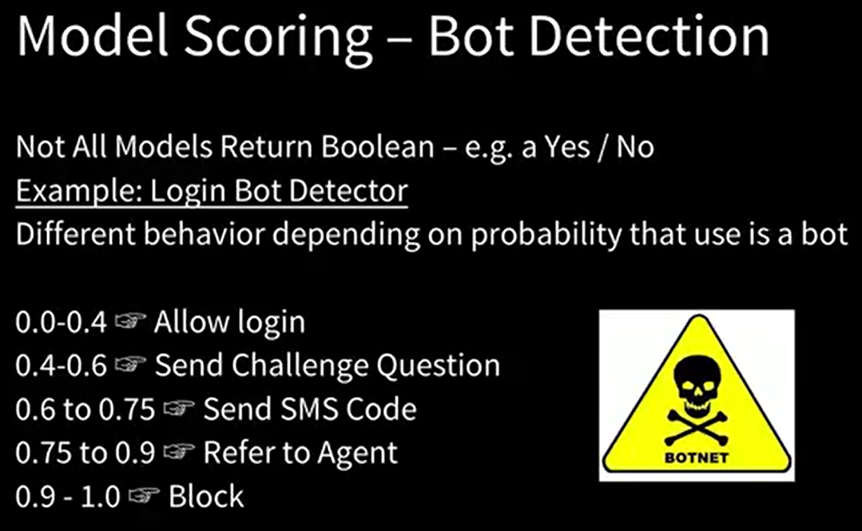
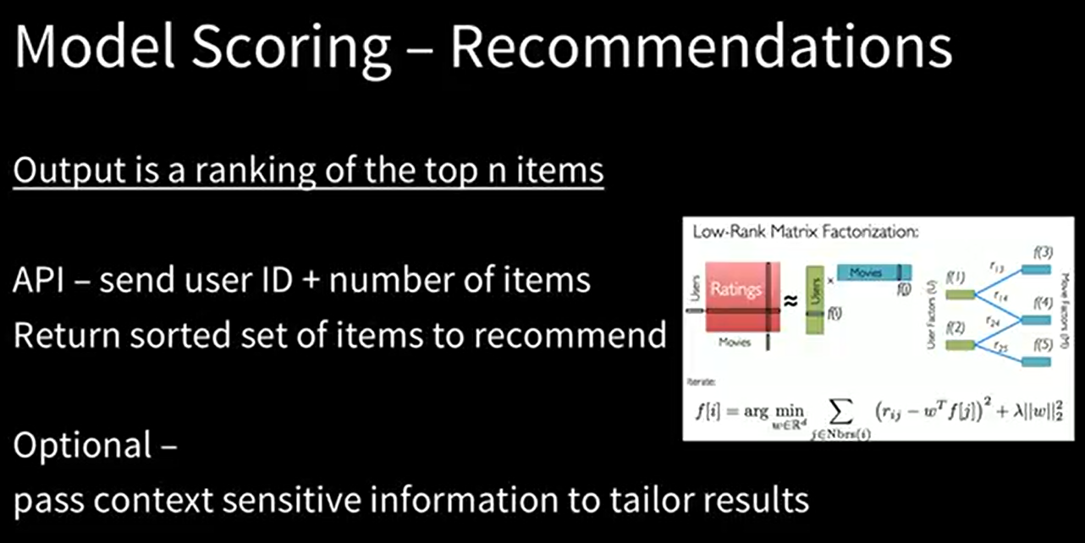
Model Scoring use cases
Spark Structured Streaming
Stream processing

Slide 31
Architecture Options – Model Scoring

Slide 32
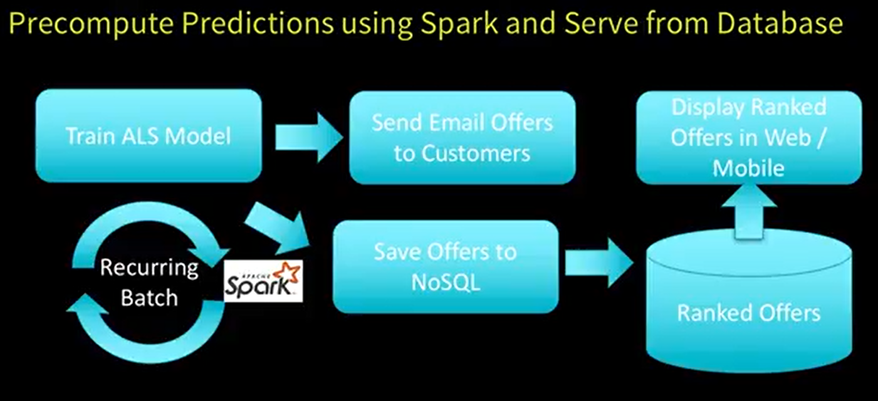



Architecture Sample 1 – eCommerce App
Spark Structured Streaming
Stream processing

Slide 33
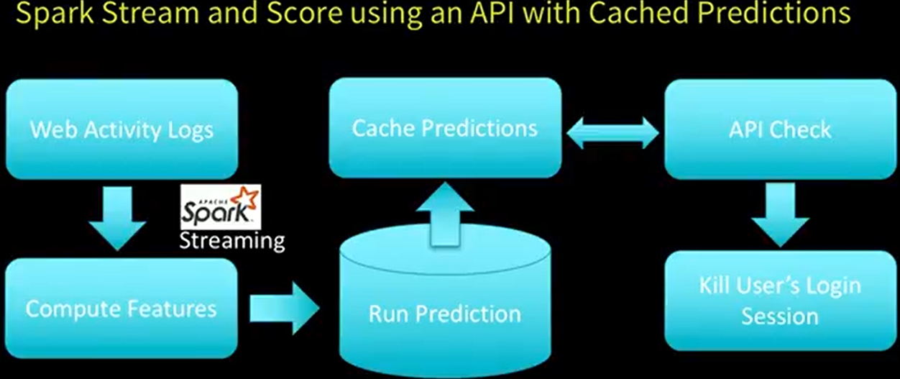
Architecture Sample 2 – eCommerce App
Spark Structured Streaming
Stream processing

Slide 34
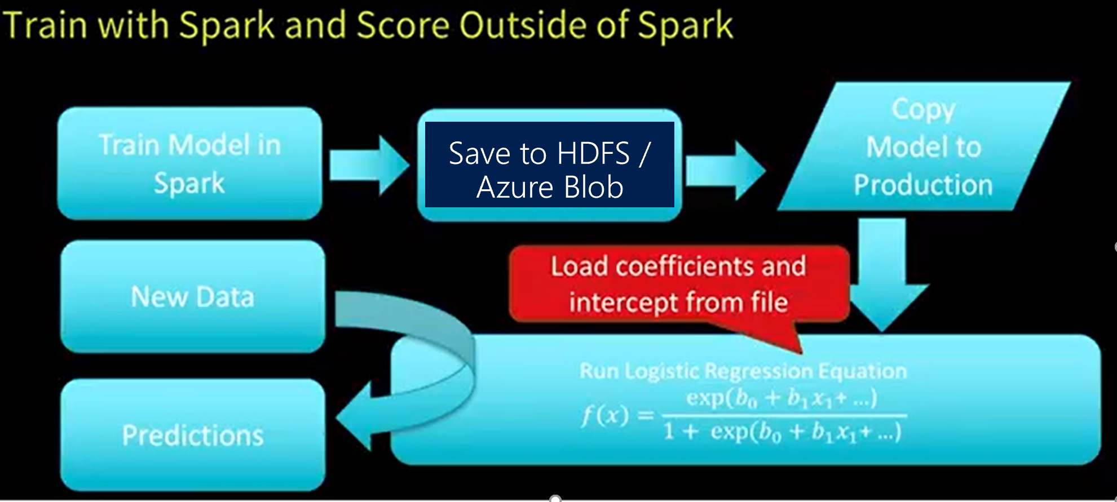
Architecture Sample 3 – Focus of the topic
Spark Structured Streaming
Stream processing

Slide 35
Azure Databricks – ML Model Export

Slide 36
Azure Databricks Model Deployment Life Cycle
Feedback:
One-line title
Would introduce three buckets similarly to slide 13
Prep and curate
Train and evaluate
Operationalize and manage
One-line title
Take AML out of ML, put it into operationalize and manage
Action:
Update title
Update iconography
Create an option with a process flow
Update layout
Fit an ML Model using Apache Spark MLLib
Export the Model into HDFS/Azure Blob Store
Import the model into an external system

Slide 37
Azure Databricks Model Deployment Options
Feedback:
One-line title
Would introduce three buckets similarly to slide 13
Prep and curate
Train and evaluate
Operationalize and manage
One-line title
Take AML out of ML, put it into operationalize and manage
Action:
Update title
Update iconography
Create an option with a process flow
Update layout
MLeap
Open sourced, Easily reuse models with serialization and executing without Spark Dependency.
Databricks ML Model Export
Consistency with Mllib
It supports serializing Apache Spark, scikit-learn, and TensorFlow pipelines into a bundle, so you can load and deploy your trained models to make predictions with new data.
Both Spark Dependency and Non-Spark Dependency

Slide 38
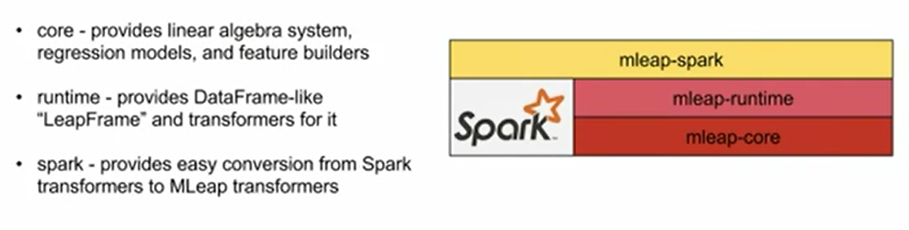
Mleap Components
Feedback:
One-line title
Would introduce three buckets similarly to slide 13
Prep and curate
Train and evaluate
Operationalize and manage
One-line title
Take AML out of ML, put it into operationalize and manage
Action:
Update title
Update iconography
Create an option with a process flow
Update layout

Slide 39
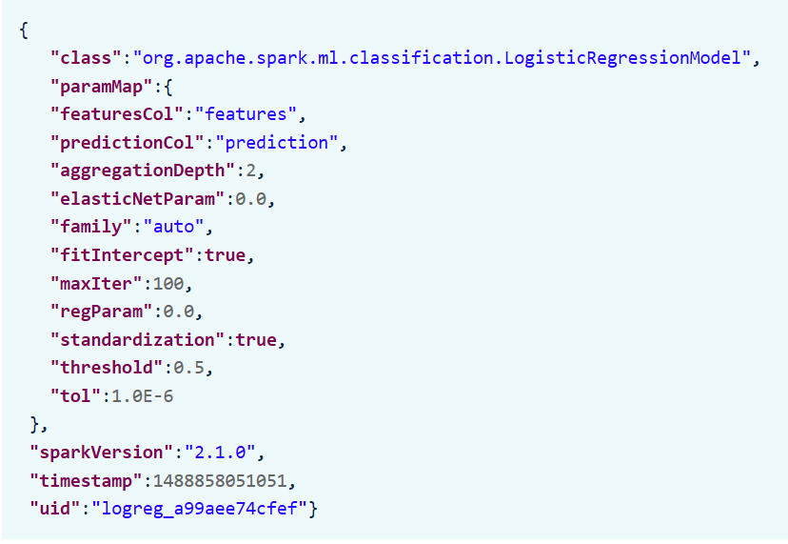
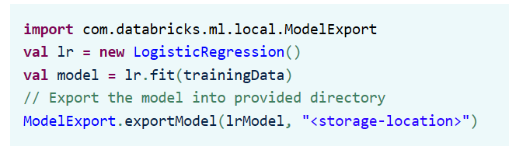
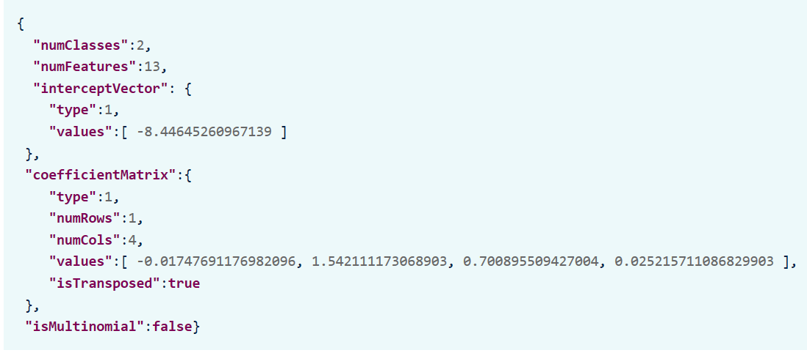
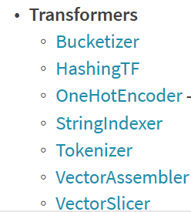
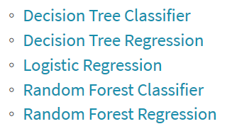
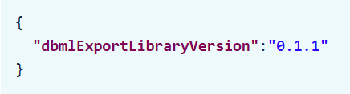
Azure Databricks - ML Model Exporter
Feedback:
One-line title
Would introduce three buckets similarly to slide 13
Prep and curate
Train and evaluate
Operationalize and manage
One-line title
Take AML out of ML, put it into operationalize and manage
Action:
Update title
Update iconography
Create an option with a process flow
Update layout
Code Snippet to Export
>")
Model Export Format
JSON which is very similar to Mleap and even PMMI is JSON format
Supported Models:

Slide 40
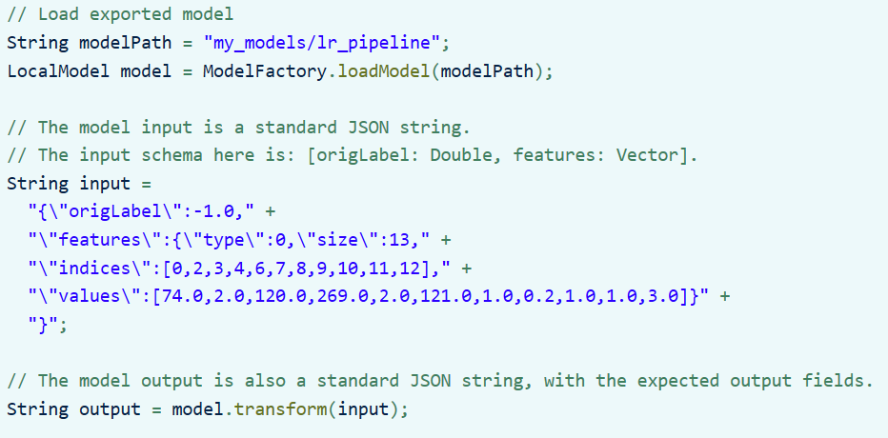
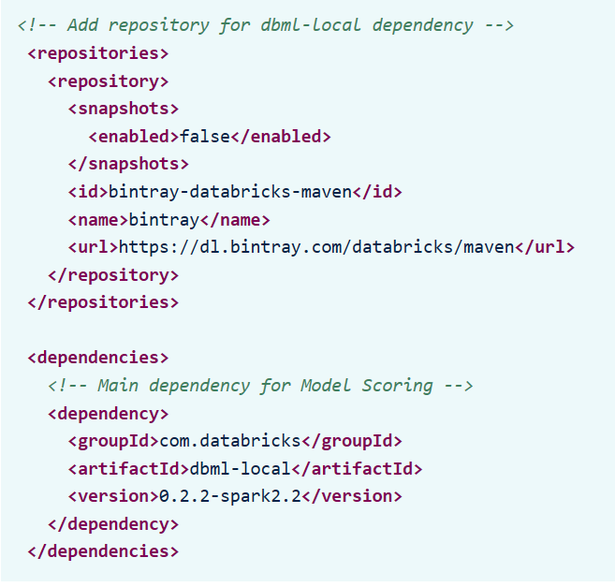
Azure Databricks - ML Model Importing to Application Layer
Feedback:
One-line title
Would introduce three buckets similarly to slide 13
Prep and curate
Train and evaluate
Operationalize and manage
One-line title
Take AML out of ML, put it into operationalize and manage
Action:
Update title
Update iconography
Create an option with a process flow
Update layout
Code Snippet to Import to App
>")
Maven Dependencies

Slide 41
What are these customers looking to do next?
Deep neural networks will be a standard component in 80% of data scientists’ tool boxes
20% of companies will dedicate workers to monitor and guide neural networks
Data scientists will no longer need to manage infrastructure or implement custom code – the systems will scale for them
2018
2019
2020
2021
2022
More than 40% of data science tasks will be automated, resulting in increased productivity and broader usage by citizen data scientists
More than half of global enterprises already using cloud today will adopt an all-in cloud strategy
Notes:
What’s the next best thing?
Taking the analytics piece and expanding that further.
I’m analyzing all of the data I have today (traditionally)
Now, I want to process images, videos (DL), and have intelligent agents and bots (AI)

Slide 42
Questions?

